Slide 1
PROJECT
PROPOSAL
Presented By:
Team 7
AbdulRaouf Monir 19P4442
AbdulRahman Ayman 19P6458
Ahmed Sameh 19P5861
Tasneem Hisham 19P4152
Elsaeed Ahmed 19P1087

Slide 2
TABLE OF CONTENTS
01
Ontology
05
02
03
04
Test Cases
DFD
Application Interface
Queries

Slide 3
1 - Ontology
The domain of a university encompasses a wide range of entities, including faculties, students, courses, majors, minors, staff, and facilities.

Slide 4
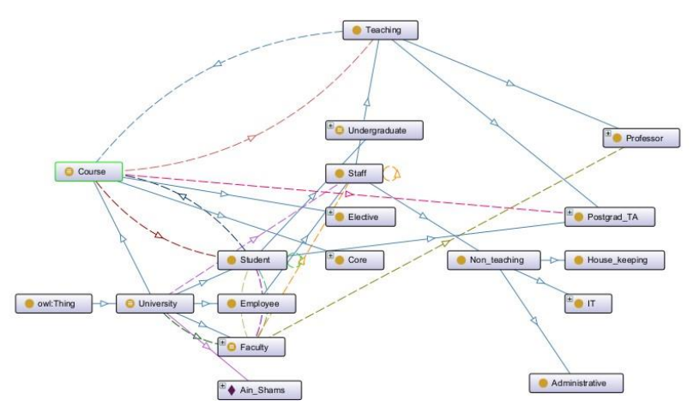
01 Ontology

Slide 5
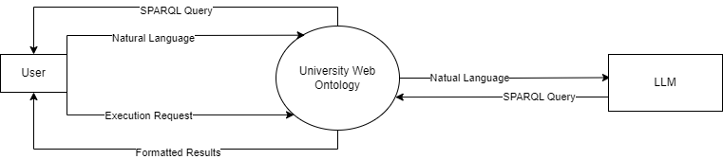
02 DFD (Context Level)

Slide 6
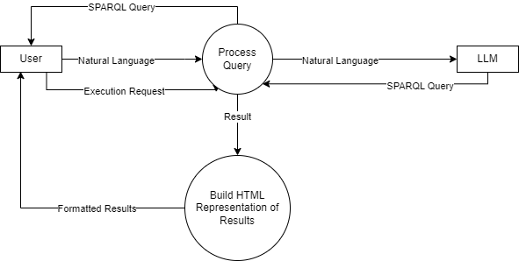
02 DFD (Level DFD 0)

Slide 7
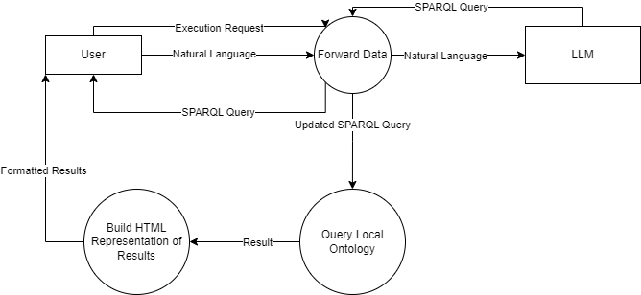
02 DFD (Level DFD 1)

Slide 8
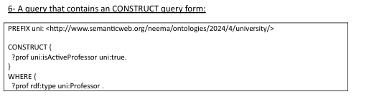

03 Queries

Slide 9

03 Queries

Slide 10
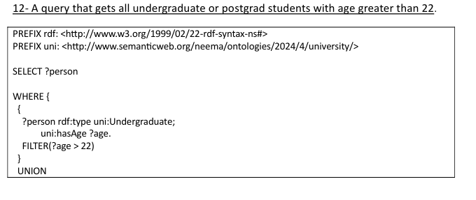
03 Queries

Slide 11
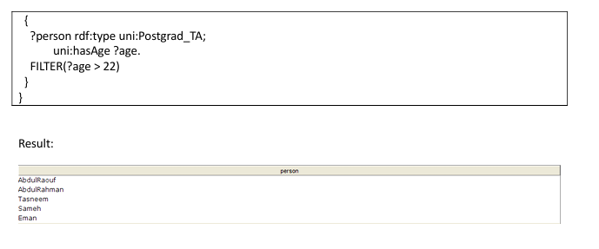
03 Queries

Slide 12
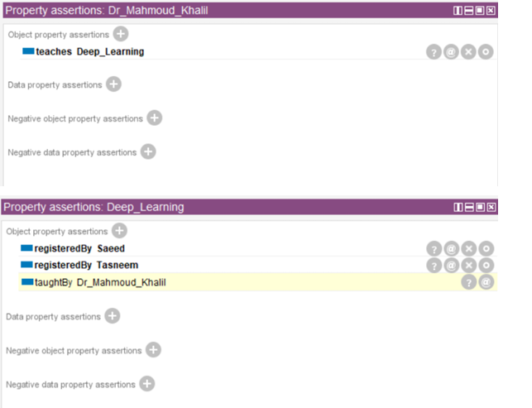
04 Test Cases
When we define that Dr. Mahmoud Khalil teaches deep learning, we expect it to infer that deep learning is taught by Dr. Mahmoud

Slide 13
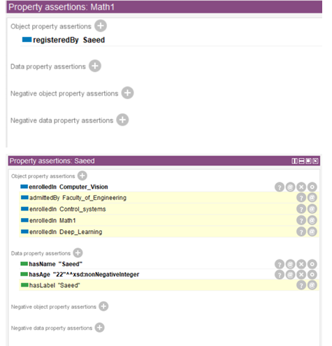
04 Test Cases
When we define that math1 is registered by Saeed, we expect it to infer that Saeed is enrolled in the course, and the same applies for the rest. It also infers that he is admitted by the faculty of engineering.

Slide 14
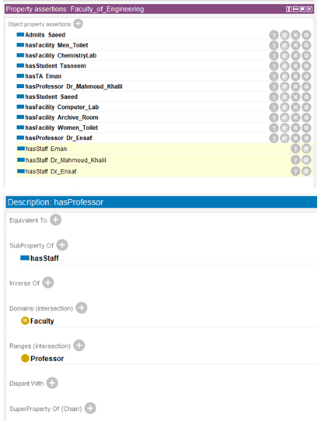
04 Test Cases
When the faculty of engineering has a professor or a TA, we expect it to infer that there are staff at the faculty of engineering.

Slide 15
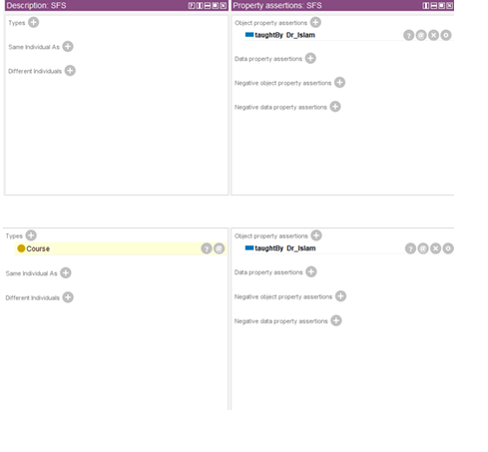
04 Test Cases
When we input that SFS individual is taught by Dr Islam, the reasoner infers that SFS is a course.

Slide 16
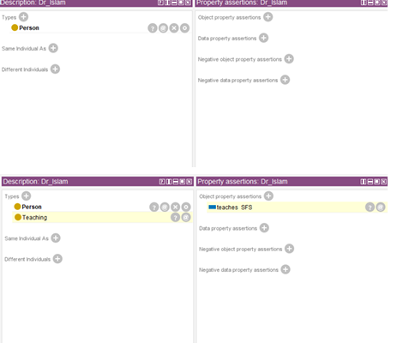
04 Test Cases
In continuation to inference of SFS is a course, Additional inference is made that Dr Islam is from the Teaching staff, and that he teaches the SFS course

Slide 17
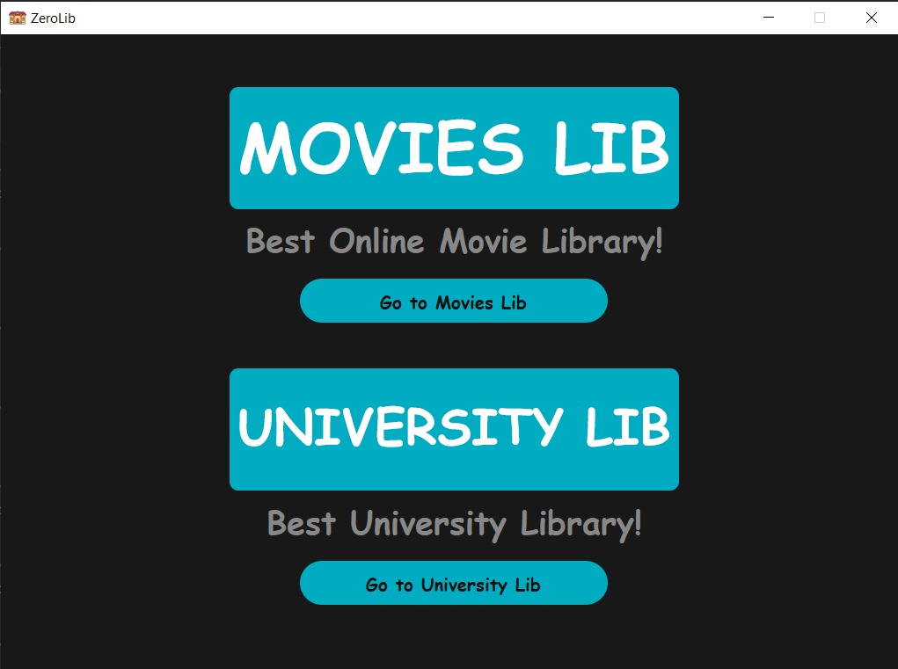
05 Application Interface

Slide 18
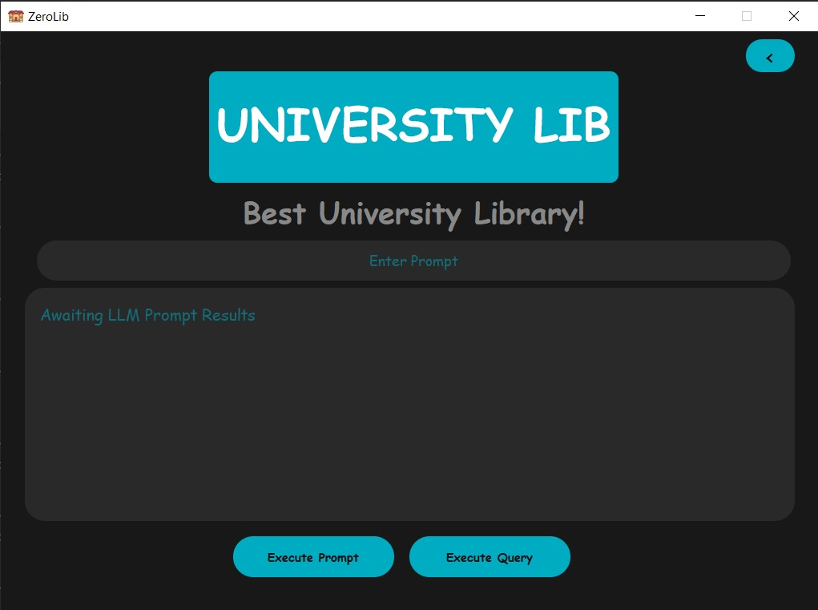
05 Application Interface

Slide 19
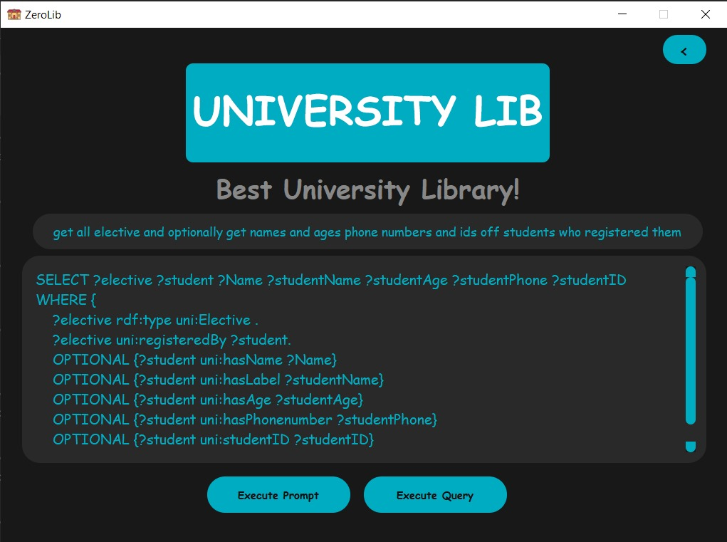
05 Application Interface

Slide 20
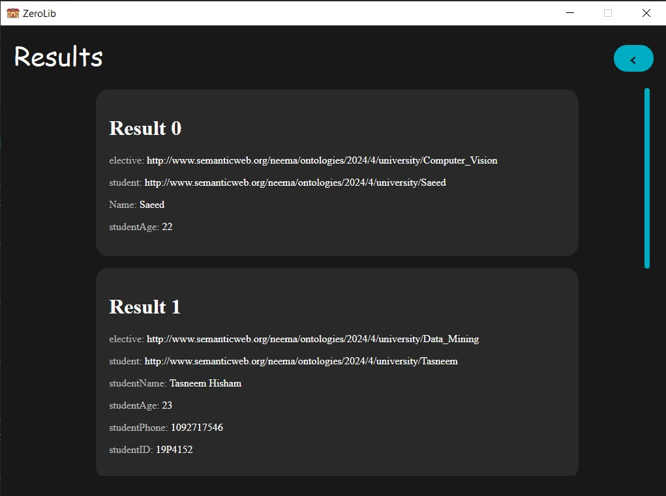
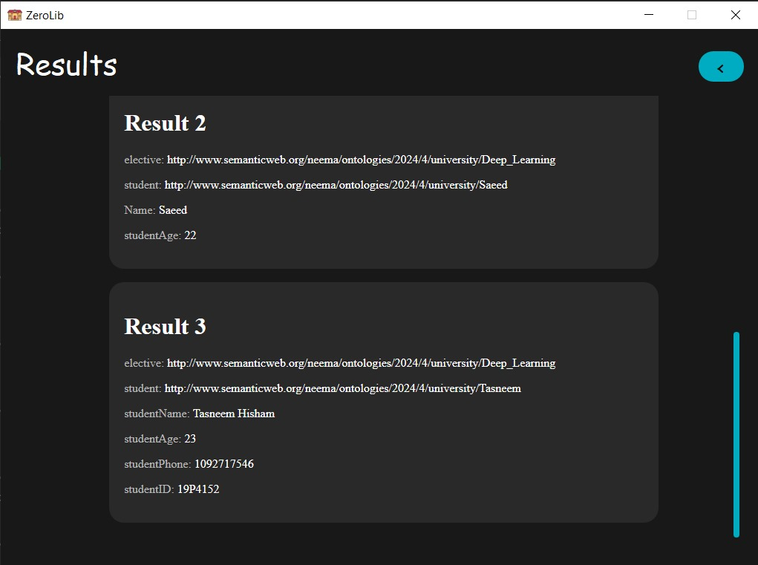
05 University Application Interface

Slide 21
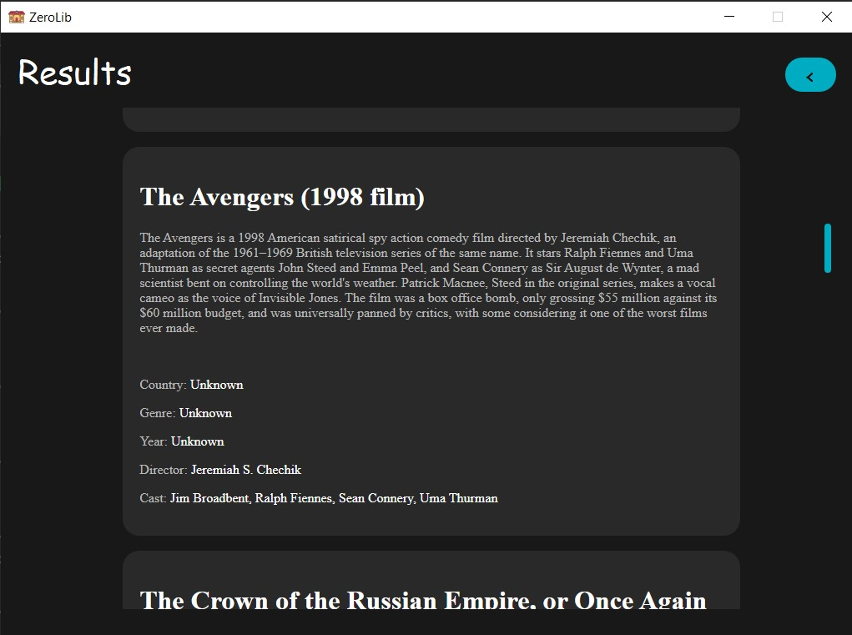
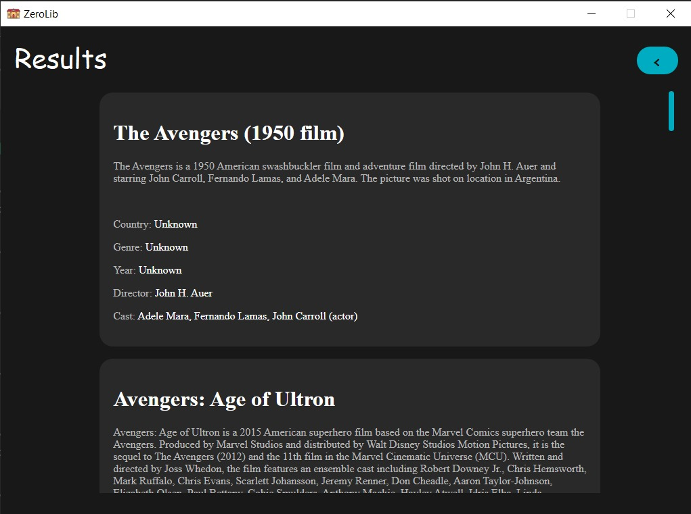
05 Application Interface

Slide 22
THANKS!
Does anyone have any question?
addyouremail@freepik.com

